Slide 1
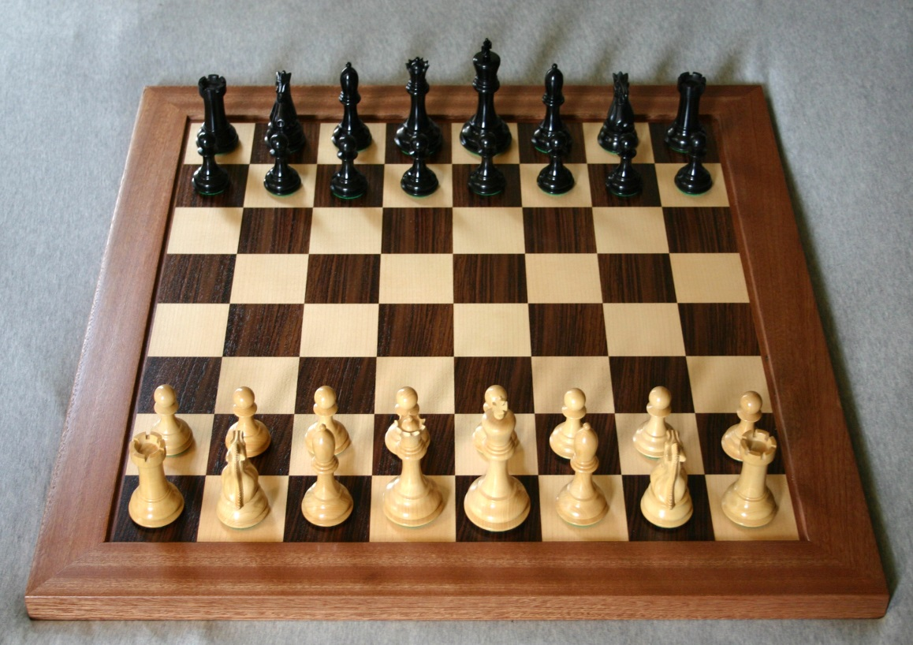
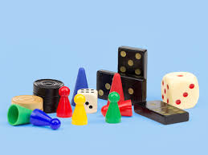
Chess Club & Board
Games - Thursdays in
the LIBRARY
3.20 - 4.00
Come and test your skills with a game of Chess. Whether you are a beginner or a pro, this club will suit everyone.
Also lots of board games to play &
challenge each other with, plus lots
of HP’s to be won !!

