Slide 1
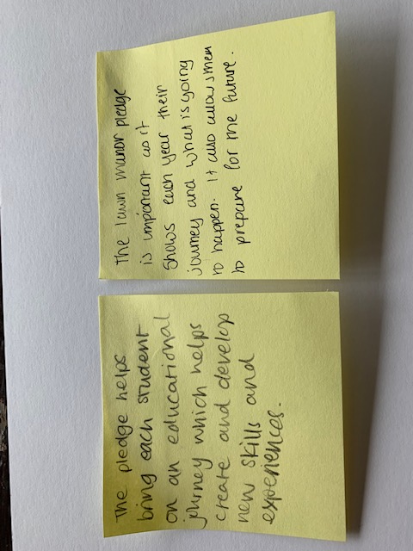

Why the Lawn Manor Pledge Matters to US - Pledge

Slide 2


Lawn Manor Academy – The Pledge Milestones
KS2
Year 8
Year 7
Year 9
Year 10
Year 11
Post 16
Disco
Literacy Festival meet the author
Year 6 Arts Mad days
Year 6 Transfer days
STEM enrichment
Transition visits
Transition celebration event
Practise interviews
Watch live theatre visit
Awards evening
Alumni stories shared with current pupils
Alumni assemblies
Volunteers workshop
Art Gallery visit
Watch live concert
Watch live concert
Virtual visit to Art Gallery Virtual Mosque tour
Opportunity to watch professional football match
Capital Visit to London, including Museum
Watch Live concert
Enrichment week
Earth day
International Women’s Day
Fire Safety event
Disco
Team building activities
Personal Development days
Personal Development days
Personal Development days
Public speaker – Holocaust Memorial
Essential skills lesson
Essential skills lessons
Careers interviews(request)
Careers interviews(request)
Careers interviews(request)
Careers interviews(request)
Careers interviews
Options Evening
Apprenticeship assembly
Enrichment week
Enrichment week
Sports Day
Sports day
Sports day
Sports day
Steps to Success evening
Steps to Success evening
Cultural day
History of LMA site walk
Live Theatre
Christmas Visit to Christ Church (Expressive Arts)
RPE Fortnight
RPE Fortnight
CV Writing
Personal Development days
Personal Development days
PSHE fortnight
PSHE fortnight
Essential skills lessons
PSHE fortnight
PSHE fortnight
ILEARN Careers fortnight
Careers ILEARN Fortnight
Careers Fair
Careers Fair
Careers Fair
Careers Fair
Careers Fair
Attend Post 16 interviews
Prom
Cultural day
Visit to Mosque (virtual)
Watch live concert
Cultural day
Year 6 Parents information evening
Year 4 Sports Day
Year 6 Vulnerable learners' day
Year 6 Parent Information evening 2
Year 5 Forest School)
Year 6 ILEARNT week
Year 6 Uniform pop-up-shop
Year 6 upcoming Connect
Cultural day
Walk through mock exams
PSHE fortnight
College applications
Watch live concert
Post 16 taster days
Employers Challenge day
Employers Challenge day
Enrichment week
Steps to success evening
Ocean & Plastic Theme
Steps to success evening
Duke of Edinburgh
Leadership opportunities
Leadership opportunities
Leadership opportunities
Leadership opportunities
Leadership opportunities
MADE
Religious Festivals:, Diwali (Oct), Christmas (Dec), Easter (April), Ramadan (February), Eid (March)
Focus Days / Weeks: Black History Month (Oct), Remembrance (Nov), Anti-Bullying (Nov), Holocaust Memorial Day (January),
International Woman's Day (March), EARTH Day (April), Children’s Mental Health Week, PRIDE (June), Welcome Week (June)
Enrichment opportunities: A published schedule of extended learning / enrichment opportunities available for all year groups.
House Sports Day: Opportunity for all to be involved
House Charity Events: Macmillan (Sept), Children in Need (Nov), Poppy Appeal (Nov), NSPCC (Jan), Comic /Sports Relief (March)

Slide 3

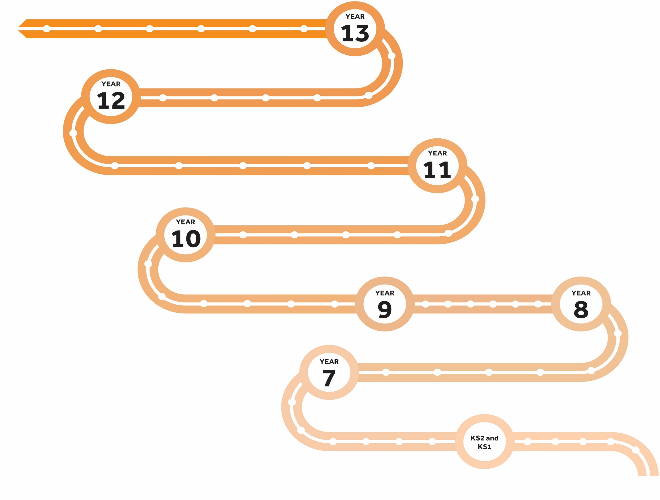
Completing post 16 applications
A-Levels
Fire safety talk with Fire Brigade,
Post 16 drop ins
Prom
Year 11 Awards
Evening
Apprenticeship
CV Writing
YEAR
Degree
11
KS 4-5 Transfer
The Lawn Manor Academy Pledge
British Value
Experience of Live Theatre - linked to KS4 English curriculum
Careers
Fair
Steps to Success evening
Post 16 interviews
MADE Workshops
Walk and talk through mock exams
Employer Challenge days
Career
Enrichment week
Post 16
tasters
Practise Interviews
Leadership opportunities
Opportunities
Personal development day
6 times a year
YEAR
10
Employer Challenge days
Duke of Edinburgh
Careers
Fair
Steps to Success evening
Enrichment week
RPE Fortnight
Virtual Assembly
KS4 only
ILEARN
Student voice
Termly questions
Visit to London
Options Evening
International Woman's Day
MADE Workshops
Welcome week
House Assemblies
(Every term)
Led by Heads of House
YEAR
Leadership opportunities
Head pupils
Prefects.
House Captains &
House assistants
Lead & Welcome Ambassadors
Peer Mentors
9
Watch live concert
Duke of Edinburgh Award
Leadership opportunities
Virtual Visit to Mosque
Careers
Fair
Charity/community events
Enrichment Week
Walking Tour of Swindon’s History
‘Volunteer workshop’
Opportunity to watch a professional football match
Disco
YEAR
ILEARN Reading
(Daily)
Assembly Theme
Apprenticeship Awareness (Y9,Y10, Y11)
Welcome week
8
Enrichment week
Watch live concert
STEM
Enrichment
Careers
Fair
Virtual tour of Art Gallery
Watch live concert
Ocean & Plastics
Welcome Week -Culture day
ILEARN
Essential skills lessons
(Fortnightly)
Yr4 LMA
Sports day
Yr 5
I LEARN
days
Yr 6
Arts Mad
days
Transfer
days
Team building
activities
Live Theatre
MADE Workshops
Careers
Fair
Public speaker – Holocaust Memorial
YEAR
Disco
Tours of school
7
Christ Church Visit
Careers interviews
by request
Email DJacklin
Open evening
Transition celebration event
at school
History of LMA local site walk
Literacy Festival
Meet the author
LAWN MANOR WAY
Assembly Theme
Termly
Lawn Manor Way
Assembly Theme
Black History Month - Oct
Assembly Theme
Remembrance Day - Nov
Assembly Theme
Holocaust Memorial Day -Jan
Assembly Theme
Earth Day
(April)
Assembly Theme
International Woman’s Day - March
Assembly Theme
Termly
Anti Bullying - Nov
Assembly Theme
(Every other term)
Rewards Assembly
PSHE Assembly
(Fortnightly)
PHSE Virtual assemblies

